Slide 1
DoD ICAM Update
For
DoDAF Plenary Day
5 January 2012
ICAM is Executive Branch Implementation of the National Strategy for Trusted Identities in Cyberspace
Paul D. Grant
Paul.Grant@OSD.Mil
Special Assistant, Federated Identity Management and External Partnering
Office of the DoD CIO
Co-Chair, Identity, Credential and Access Management Sub-Committee, Federal CIO Council
www.IdManagement.Gov
https://www.us.army.mil/suite/page/647425

Slide 2
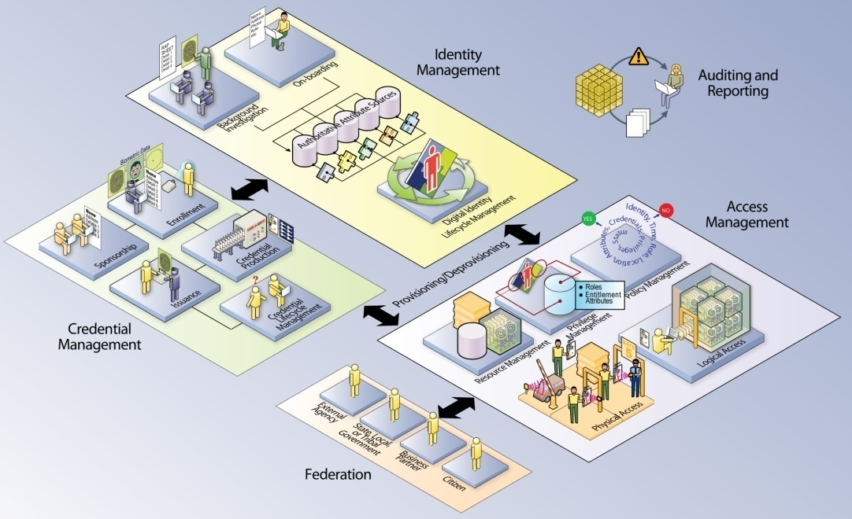
FICAM Key Components
FICAM Service Areas
Digital Identity
Credentialing
Privilege Management
Authentication
Authorization & Access
Cryptography
Auditing and Reporting
ICAM represents the intersection of digital identities, credentials, and access control into one comprehensive approach

Slide 3
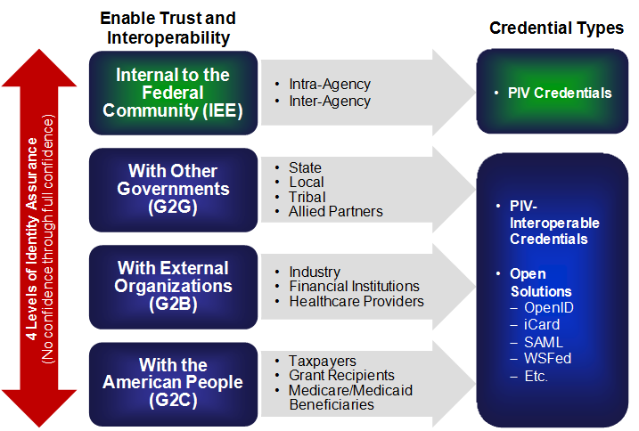
ICAM Scope
Persons
Non-Persons
Logical Access
Physical Access
Foundation for Trust and Interoperability in Conducting Electronic Transactions both within the Federal Government and with External Partners

Slide 4
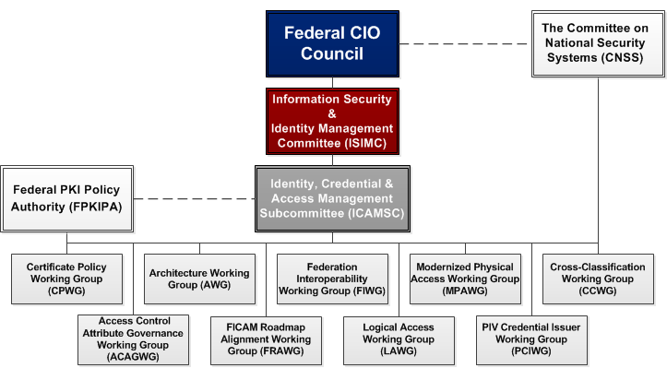
Evolving
FICAM Governance Structure

Slide 5
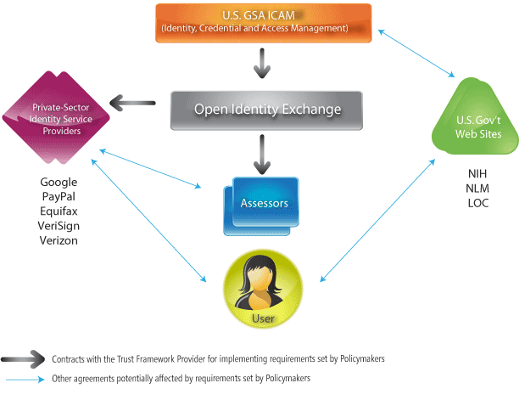
Non-Federally Issued Credentials and the DoD
DoD is accepting approved IAL- 4 (Including PIV-I ) and approved PIV-I providers can be found at: http://iase.disa.mil/pki-pke/index.html
DoD is drafting an approval process and implementation guidance for credentials approved through the Federal Trust Framework Process at IAL 1,2, and 3 (non-PKI)
Federally approved providers and information about the TFPAP can be found at: http://idmanagement.gov/pages.cfm/page/IDManagement-open-identity-solutions-for-open-government
Trust Framework Provider

Slide 6
Reference Architectures in the
DoD-CIO Campaign Plan
The DoD CIO Campaign Plan calls for the creation of reference architectures:
Task 3.1.1.4 Publish the DoD ICAM Reference Architecture.
Task 1.2.6.2 Develop and publish the Identity Management Reference Architecture.
These two tasks will be combined into one ICAM/IdAM reference architecture within the DoD Enterprise Architecture
All systems and applications will need to align with this reference architecture

Slide 7
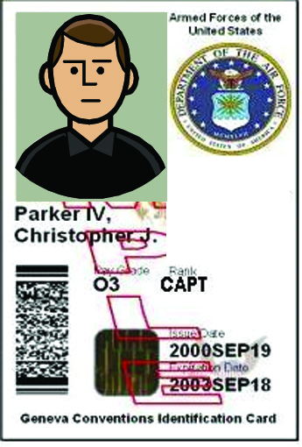
DoD ICAM Target State: Dynamic Access Control
Environmental
Factors (e.g., DEFCON,
INFOCON, Etc.)
Policy-Based Authorization Services
Policy
Enforcement
Point (PEP)
User/Device
Resource
Policy
Decision
Point (PDP)
Resource
Management
Authenticate
Policy
Store
Identity Management
Credential Management
User/Device
Attribute Management
Resource Attribute Management
Digital Policy Management
Audit Management
Identity & Credential
Management
Policy Management

Slide 8
Summary and Next Steps
The DoD
Has provided leadership in creating the Federal ICAM
Is making progress on alignment with ICAM
Is Producing the DoD ICAM Transition Plan
Will Produce the ICAM/IdAM Reference Architecture
ICAM/IdAM Message Must Be Clear, Consistent, Credible
ICAM seeks increased DoD participation and leadership
DoD applications Must Use Appropriate Level of Assurance Credentials
ICAM Expects IAL-4 within the Executive Branch (i.e., PIV Cards)
IAL- 2 – 4 from Non-Federal Issuers will be used based upon risk and mission
The On-Going Work on Attribute Based and Policy Based Access Control is Increasingly Gaining Momentum

Slide 9
BACK UP
FOLLOWS

Slide 10

Identity Federations (PKI Based)
Shared Service Providers
VeriSign, Inc.
Symantec
Operational Research Consultants, Inc.
The Department of the Treasury
Entrust Managed Services
U.S. Government Printing Office
Cross Certified:
D of Defense D of Justice
Gov Printing Office D of State
D of Treasury USPS
Patent & Trademark Ofc DHS
State of Illinois DEA CSOS
Credential Svc Providers:
VeriSign Verizon Business
Entrust ORC
DoD ECAs (ORC, IdenTrust, VeriSign)
ACES (IdenTrust & ORC)
Federal Common Policy Root
Federal
Bridge
Participants
Cross Certified:
Boeing
Lockheed Martin
Northrop Grumman
Raytheon
EADS/Airbus
MOD NL
Credential Svc Providers:
Exostar, SITA, ARINC,
CitiBank,
HID (ActivIdentity)
BAE Systems (Exostar)
Participants:
AstraZeneca
Bristol-Myers-Squibb
Genzyme
GlaxoSmithKline Johnson & Johnson
Merck
Nektar
Organon
Pfizer
Procter & Gamble Roche
Sanofi-Aventis
Certipath (Aero/Def)
Cross Certified at “Commercial Best Practices” Level
PKI Bridges
Interoperable @ test level;
HE Bridge dormant
SAFE
(Bio/Pharma)
Higher
Education
Red: IAL-4
DoDI 8520.03
Fed Bridge Status: http://www.idmanagement.gov/fpkia/crosscert.cfm
Certipath Status: http://www.certipath.com/certipath-bridge/piv-i-issuers
Notes:
Current PIV-I issuers cross certified with the Federal Bridge:
Approved PIV-I Providers:
VeriSign, Inc. (A Symantec Company) VeriSign Non-Federal SSP PKI in conjunction with the Intercede MyID CMS (version MyID8 SR1 and MyID 9) For more information contact: Nick Piazzola (Senior Director, Government Authentication Solutions) at 443-604-4069 or via email at "nick_piazzola@symantec.com"
Verizon Business For more information contact: Deborah Blanchard (Sr. Product Manager, Public Sector) at 410-871-0836 or via email at "deborah.blanchard@verizonbusiness.com"
Entrust Entrust NFI SSP in conjunction with the XTec AuthentX™ CMS For more information contact: Jeff Brooks, Director, Entrust Federal at 703-391-2658 or via email at "jeff.brooks@entrust.com" or Tom Murphy, Director of Sales, XTec at 703-547-3524 or via email at "tmurphy@xtec.com"
Approved PIV-I Bridges:
CertiPath For more information, contact Sergio Smith (Senior Director of Corporate Development Operations) at # 703-793-7871 or via email at "sergio.smith@certipath.com"

